Slide 1
LARP Annual DOE Briefing
Eric Prebys, Fermilab
Director, US LHC Accelerator Research Program (LARP)

Slide 2
Outline
Highlights since last briefing (2/16/2010)
HL-LHC design study
Selected topics from Chamonix and LARP/CERN meeting
Response to major recommendations from July, 2010 review.
Budget status
Magnet systems update – GianLuca Sabbi

Slide 3
Reminder: where we were a year ago
CERN/LHC
Had started up in late 2009, but had only reached 1.18 TeV/beam
Chamonix recommendations:
Limit energy to 3.5 TeV+3.5 TeV
Run for two years or 1 fb⁻¹, then shut down for 15-18 months to fully repair joints
Defer PS2 (not necessary for LHC)
Investigate increasing energy of PSB instead.
Cancel “Phase I” upgrade and focus on a single upgrade incorporating Nb₃Sn quadrupoles and (probably) crab cavities
LARP
Instrumentation delivered, but some questions remained
Eg, not sure how effective lumi monitor would be at 3.5 TeV
4 m 90 mm LQ had reached 200 T/m
Test goal, but knew it could go higher based on TQ’s

Slide 4
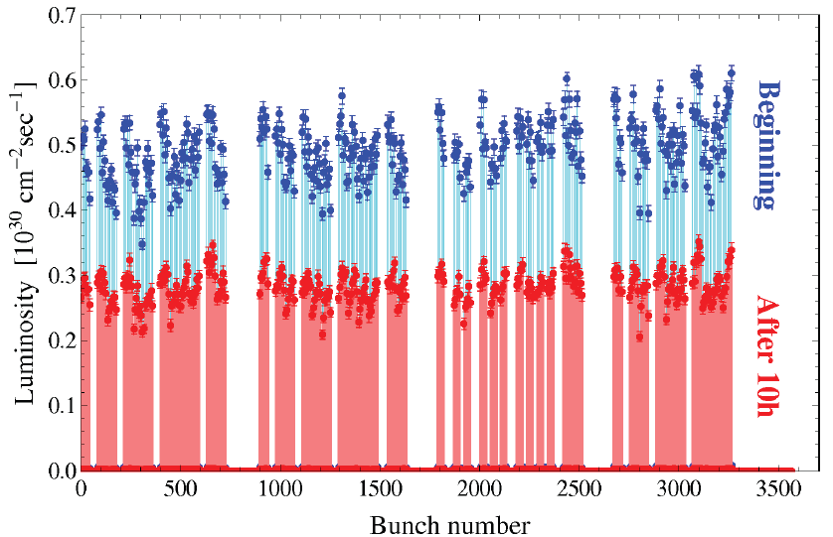
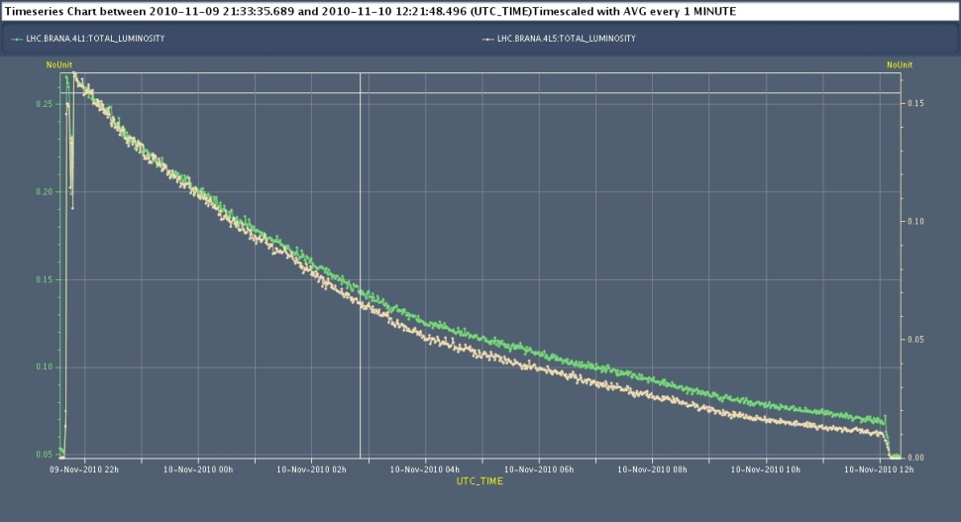
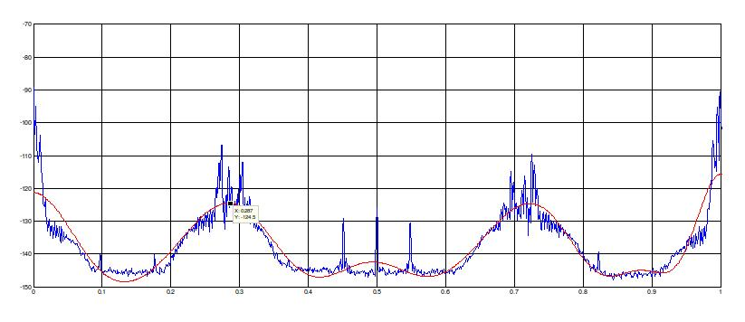
Instrumentation
Luminosity monitor
Primary tool for fast luminosity measurements and VDM’s
Schottky Detector
Can now be used for bunch by bunch tune measurements
Improved support for remote access to data
per bunch lumi
ions

Slide 5
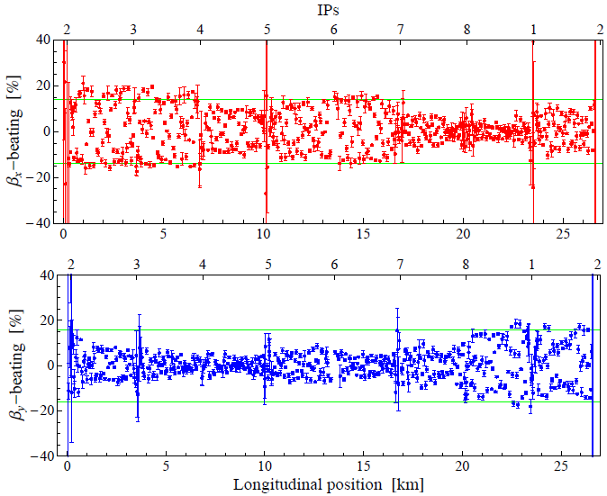
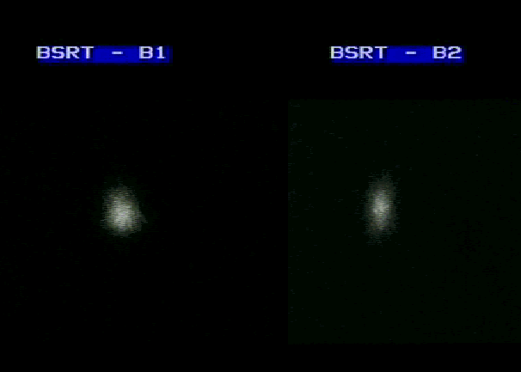
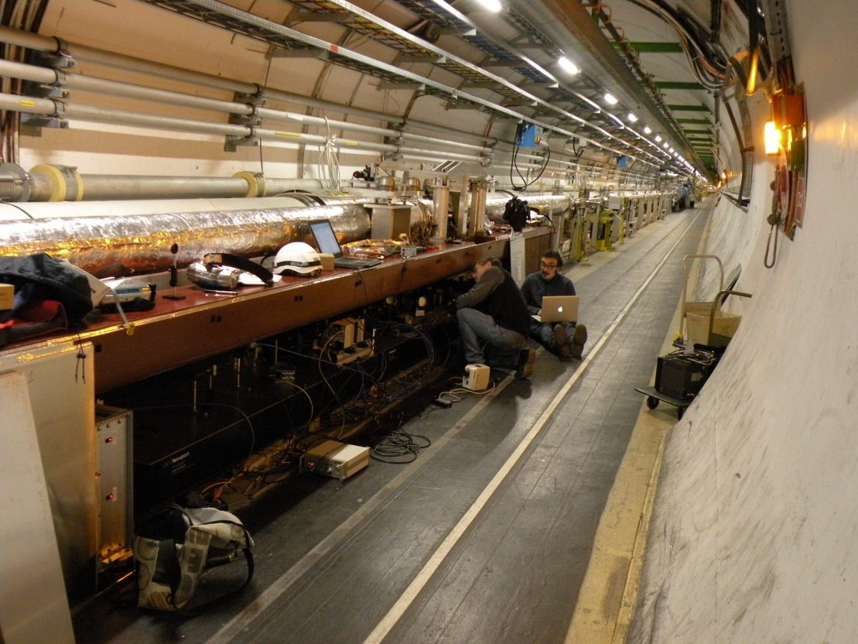
Instrumentation (cont’d)
AC Dipole
Has become the primary tool for high field optics measurements
Sync. Light Monitor (SLM)
Saw ion bunches
Focal problem identified and fixed, which should eliminate inconsistency between SLM and flying wire.

Slide 6
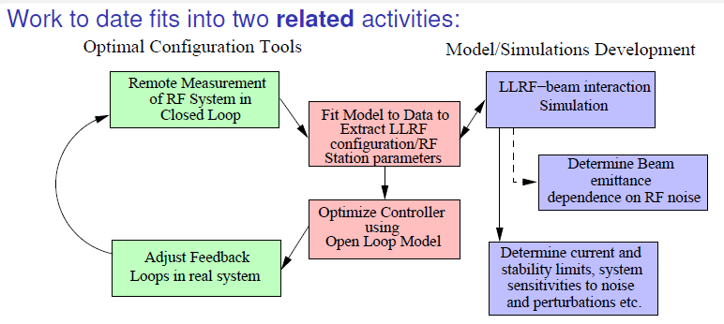
Instrumentation (sort of)
LLRF Tools
Leverage RF tools and techniques developed at PEP-II
Configuration tools used extensively during LHC RF commissioning and operation.
Supportive letters from CERN RF personnel.

Slide 7
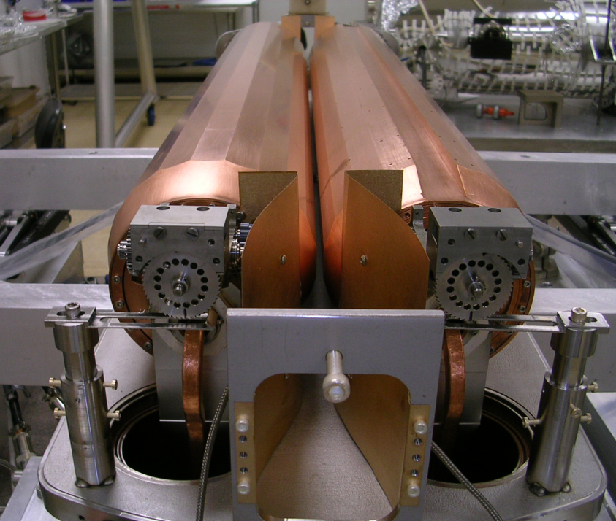
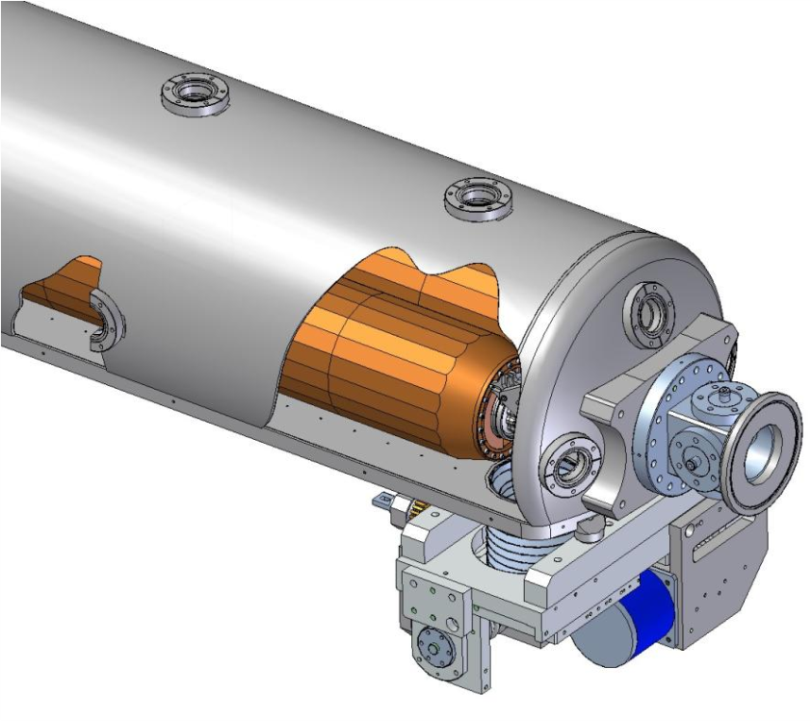
LARP Rotatable Collimator Prototype
Rotation Drives
BPM
Assembly complete and tested in final configuration where jaw rotation twists cooling tubes but leaves RF foils immobile with <1 mOhm resistance
Next Steps:
Weld on vacuum tank cover, evacuate, retest; vacuum bakeout, RGA scan at 10⁻⁹ torr, retest.
Ship to CERN in early April, retest & fiducialize at CERN, install in SPS
Details of destructive tests in HiRadMat Facility under discussion
Whether/how to partner with CERN for production versions needs guidance

Slide 8
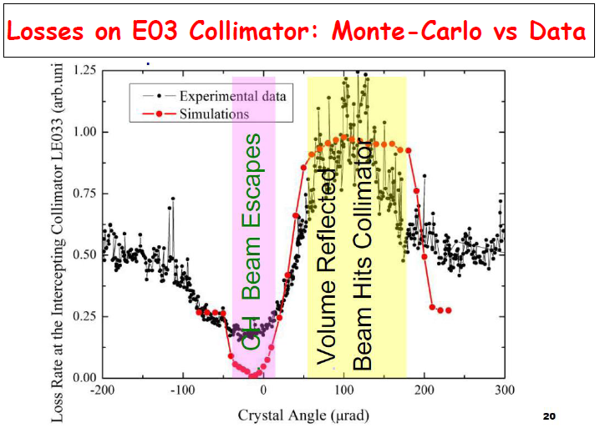
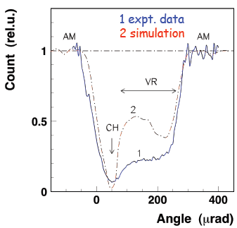
Crystal Collimation: UA9(CERN) and T980(FNAL)
Both experiments saw improved configuration in 2010
UA9: improved goniometers and instrumentation installed over winter shutdown
T980: New crystals and instrumentation
Very impressive channeling data from both experiments
T980
UA9

Slide 9
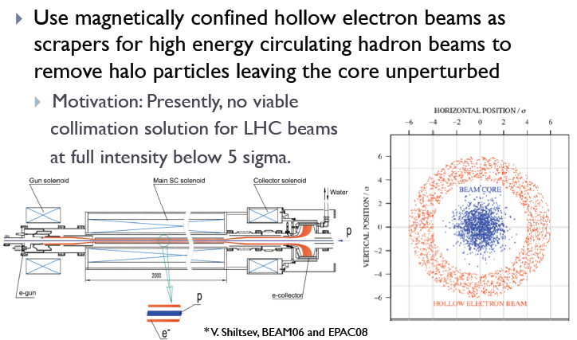
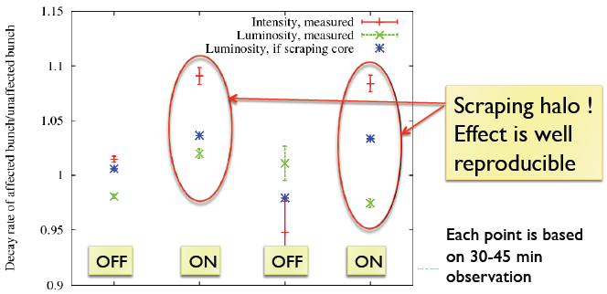
Hollow Electron Beam Collimation

Slide 10
PS2/PSB
As agreed, LARP has submitted material for the PS2 white paper covering
E-cloud
Impedance
Space Charge
We have begun to transfer this expertise to the PSB energy upgrade effort
Because of budgetary constraints, other suggested contributions, such as IPM’s, had to be canceled.
Discussion: How much LARP presence is expected in the PSB effort?
Currently very little has been budgeted

Slide 11
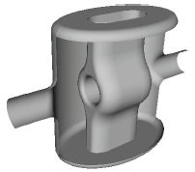
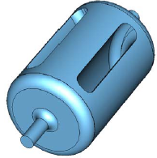
Crab Cavities
Important decisions at CC10
KEK crab cavity test in SPS canceled
Still feel a test of some sort in SPS is required, but should be better thought out and more closely aligned with ultimate goals.
Adopt 400 MHz, compact, local scheme as base line unless proven unworkable.
Appear to be 3-4 potentially workable designs.
LARP has supported SLAC and Jlab. May support new BNL concept.
Complete conceptual design of 800 MHz elliptical as a backup.
Discussion points
What will the long term plan for US involvement be?

Slide 12
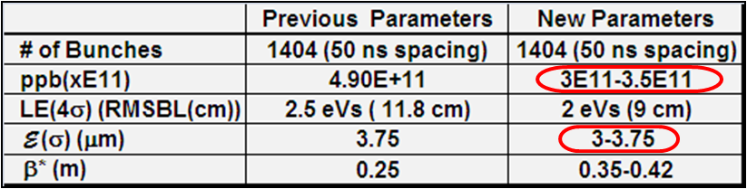
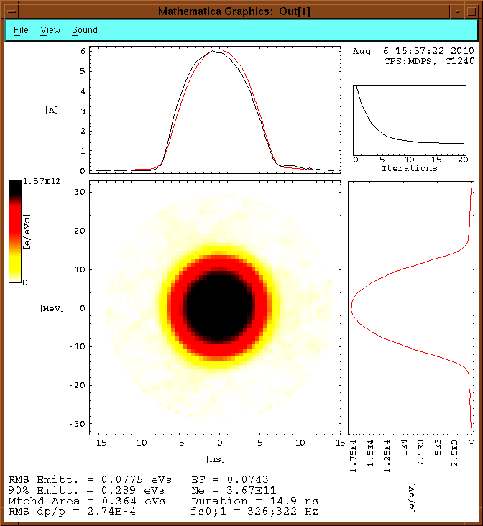
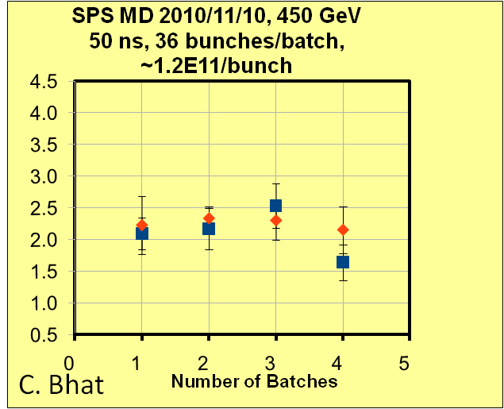
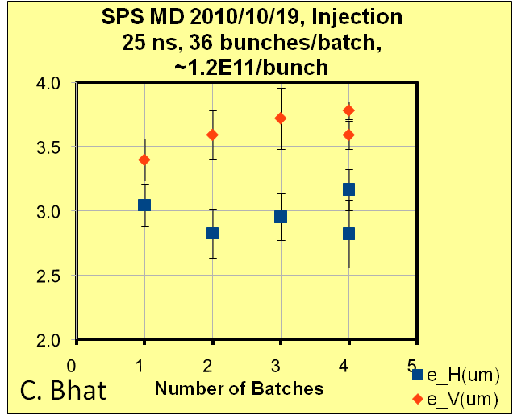
Large Bunch Studies for LPA Solution (C. Bhatt)
Have come up with a new set of flat bunch (LPAS) parameters in view of the re-stated SLHC L_{peak} goal (≥5×10³⁴cm⁻²sec⁻¹) & estimated bb tune shift (<0.02) from LHC data
Performed studies of large bunches in the PS, as well as emittance growth studies for various bunch spacings
Bunch at 20ms before
Ejection
Aug. 6, 2010:
~3.7E11p/bunch

Slide 13
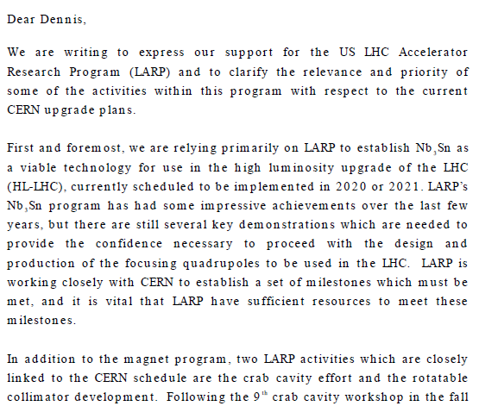
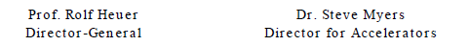
Relevance of LARP to CERN Upgrade*
Letter to Dennis Kovar, Head, DOE Office of High Energy Physics, 17-August-2010
(…)
*letter suggested at review

Slide 14
LARP Long Term Visitor Activity
This year, LARP supported four long term visitors:
Uli Wienands (SLAC)
PS2 close out
LARP PSB coordination
UA9 work
Chandra Bhatt(FNAL)
Long bunch studies for LPA option
Rama Calaga (former Toohig Fellow)
Commissioning
Crab Cavities
Eliana Gianfelice-Wendt
Gap cleaning studies
In addition, former long term visitor Alan Fisher has continued to make contributions to the SLM system.

Slide 15
LARP Toohig Fellows
Continuing Fellows
Dariusz Bocian (FNAL)
Working on modeling of the Nb3Sn magnets
Extended for third year
Ryoichi Miyamoto (BNL)
AC Dipole and Lumi monitor
Extended for third year
Riccardo DiMaria
Left Toohig Fellowship to become CERN Fellow
New Fellows
Simon White (BNL)
luminosity measurement, electron lenses
Themis Mastoridis (SLAC)
LLRF and high bandwidth SPS damping system

Slide 16
CERN Re: LARP Personnel Programs
Letter to Michael Procario, Acting Head, DOE Office of High Energy Physics, 9-MARCH-2011

Slide 17
HL-LHC Design Study
Upgrade planning will be organized through EuCARD*,
Centrally managed from CERN (Lucio Rossi)
Non-CERN funds provided by EU
Non-EU partners (KEK, LARP, etc) will be coordinated by EuCARD, but receive no money.
Work Packages:
WP1: Management
WP2: Beam Physics and Layout
WP3: Magnet Design
WP4: Crab Cavity Design
WP5: Collimation and Beam Losses
WP6: Machine Protection
WP7: Machine/Experiment Interface
WP8: Environment & Safety
Significant LARP and other US Involvement
Over and above current collimation plan (IR3, 7 and Phase II)
*European Coordination for Accelerator R&D

Slide 18
US Participation Over Next Four Years
LARP and other (Average FTE’s for four years):
Submitted: November, 2010
Breaking news: proposal received perfect 15/15 score in evaluation.
Goals
Preliminary Design Report: mid-2013
Technical Design Report: end of 2014

Slide 19
Some Key Results From Chamonix (wrt LARP)
Energy=3.5+3.5
Most anticipated decision, but no real effect on LARP
Schedule
As expected, the LHC will run through 2012
Good news for everyone involved with the shutdown
Will delay “2016” and “2020” shutdowns
Affects LARP, but not quantified yet.
Collimation
Beam losses lower than anticipated, so existing collimation very effective.
Will probably still be a place for rotatable collimators, but probably no need to increase LARP collimation involvement.
E-Cloud
The SPS high bandwidth feedback system was discussed and the LARP effort specifically mentioned.

Slide 20
CERN Collimation Upgrade Plans
Various upgrades are discussed
LARP designed Phase II secondary collimators for the 2 x 15 prepared slots
CERN designed Phase II secondary collimators
Integrated BPMs expected to ease current time consuming collimator setup
“Cold” Collimators in SC Dispersion Suppressor Regions around IR3, 7, 1, 5, …
Requires transverse & lateral displace of all SC dipoles to make space
Conversion of IR3 from momentum to combined betatron/momentum cleaning
Perhaps only this region needs the “Cold” DS collimators with expensive dipole move
High Field Dipoles to minimize disruption to SC dipoles in DS regions
Hollow E-beam scraper
For each scenario, R&D, Engineering, Prototyping and Studies are in progress
But no decisions have been made
Halo formation at LHC less than anticipated and luminosity at which collimation becomes a bottleneck is higher than thought before LHC operations began
A discussed scenario is to install CERN Phase II secondary collimators into the prepared slots to gain operational efficiency and to replace current W tertiary collimators around each IR with LARP rotatable collimators if DOE wants to fund it
4 IRs with 4 collimators each plus spares

Slide 21
Discussion: High Bandwidth Feedback for SPS
This is a topic that has a great deal of interest at CERN
It’s on of the few LARP activities that was discussed in some detail at Chamonix.
It’s an area that could easily grow to eat up a lot of the AS budget as lumi and rotatable collimators ramp down
Particularly if we can move crab cavities out of LARP
Should we continue to pursue it?
Other option would be to increase our involvement in the PSB energy upgrade.

Slide 22
July 2010 Review: Selected Accolades
From the Executive Summary

Slide 23
Recommendations and Responses
Accelerator Physics - perform simulations in the coming year to help guide CERN’s choice of quadrupole aperture
It would not be an effective use of our resources to develop an independent design and simulation effort for the LHC upgrade.
This is obviously a critical part of the design study (WP2), and LARP’s accelerator physics effort will be coordinated with that.
The integration of the magnet effort into the design study will provided vital feedback to the optical design.

Slide 24
Recommendations (cont’d)
Crab Cavities—work with CERN to develop clear specifications and a realistic R&D plan with goals for the crab cavities.
The CC10 workshop in December provided a clear path for the base line approach to crab cavities
Focus on compact (400 MHz) local schemes.
Bring the proposed designs to an equivalent state of conceptual design and make a down selection.
Continue to search for show stoppers in the area of machine safety
The exact structure and organization of the crab cavity effort will come out of the design study WP4.
LARP plans to continue to support the crab cavity effort at the level of ~$400k/year for the next year or so, while (we hope) an independent effort develops.

Slide 25
Recommendations (cont’d)
Magnets—undertake, in close consultation and cooperation with CERN, a substantial role for modeling energy deposition and radiation damage from beam losses and other collider issues related to the IR quad aperture decision
We fully agree that this is a vital issue, given that the next generation focusing quadrupoles must be significantly more radiation hard than the existing ones.
We are developing a plan to exploit the talents of the Fermilab and SLAC’s energy deposition groups to systematically model the energy deposition in the Nb₃Sn magnets.
This will be integrated into design study WP2 and WP3.
Nikolai Mokhov estimates 1.5-2 FTE on our part which is not yet budgeted into the plan
CERN is making plans to do any necessary experiments related to radiation damage, and we plan to take part as needed.

Slide 26
Recommendations (cont’d)
LARP management—develop a strategic plan for LARP R&D that supports the LHC schedule, and meets the FY11 budget; and work with DOE and CERN to establish a formalism for the dialog and protocol which will provide the needed specifications in time to meet agreed upon milestones.
We believe that this recommendation will be naturally satisfied by the close coordination of the LARP with the HL-LHC design effort.

Slide 27
Budget Status (as of March 1)
Totals

Slide 28
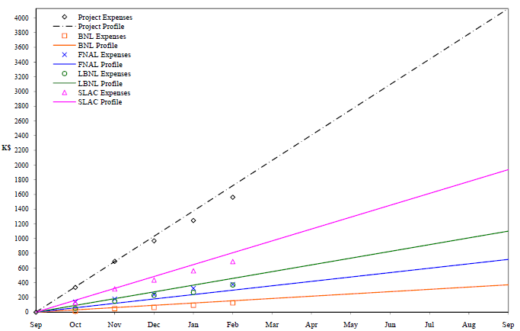
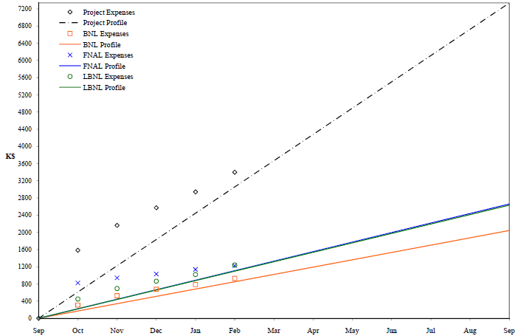
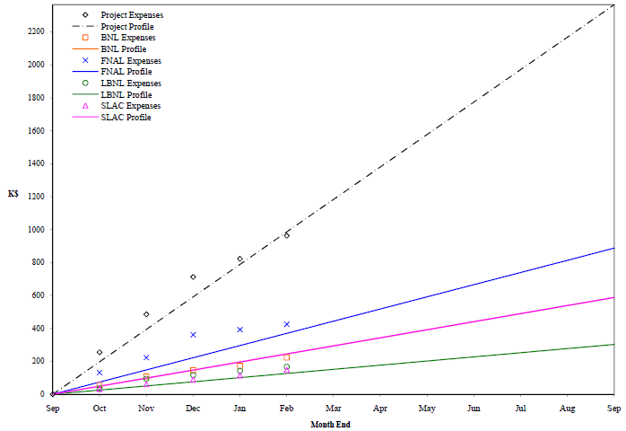
Subtasks
Accelerator Systems
Large Conductor Purchase
Magnet Systems
Programmatic Activities

Slide 29
Contingency
Our original guidance leaves $2.2M in DOE held contingency
What is the status of this in the current budget landscape?
Although we are doing well on keeping track with the current budget, we have always assumed that we would have access to the contingency
We plan to submit a request by the end of this month for a May 1st release.

Slide 30
Accelerator Physics Contingency Needs
LARP/LBNL Luminosity
Extra ~1/3FTE requested to continue commissioning of device as LHC luminosity grows
Development of activities in HL-LHC plan:
Accelerator Physics Task
Support of single particle tracking and E_loss maps for lattices under consideration
In line with DOW Review recommendations
1.6 FTE at SLAC identified
Support of Energy Deposition studies in IR magnets
As recommended by DOE reviewers
FNAL &/or SLAC FLUKA team
Supported by SLAC management
Requests from LBNL (2.0FTE) & SLAC (0.5FTE) for collective effect subtask
Crab Cavity Task
Computational support (modes, multipactering) for ALL designs under consideration
HL-LHC initial planning much greater than current LARP commitment
SLAC & LBNL staff identified

Slide 31
Programmatic Contingency Needs
Toohig Fellowship
BNL will need some contingency to cover Simon White’s Toohig Fellowship
LTV Program
There will be a slight shortfall in the LTV account because of higher than anticipated COLA costs
COLA based on CHF/$ exchange rate.

Slide 32
Final Comments
We feel that LARP has been and continues to be a very effective program
Well reviewed
Very positive feedback from CERN
We continue to be resource limited
With the advent of the HL-LHC design study, it’s clear that there is significantly more interest and talent in the US than the funding can support.
We are continuing to plan for a ~flat level of funding over the next few years
Of course, we would be able to effectively use significantly more.

